Slide 1

Machine Learning
& Facial Recognition
August 15th, 2020
James, Paul, Tanvir, Nicky, Fabienne

Slide 2



Our Team

Slide 3






Our Team
Background on our Project Topic
Our AI Model
Our Results
Conclusion
The Invincible Five
James
CEO Photo Checker
Nicky
CTO Photo Checker
Fabienne
CFO
Photo Checker
Paul
CCO
Photo Checker
Tanvir
CMLO
Photo Checker

Slide 4

Background on our
Project Topic

Slide 5
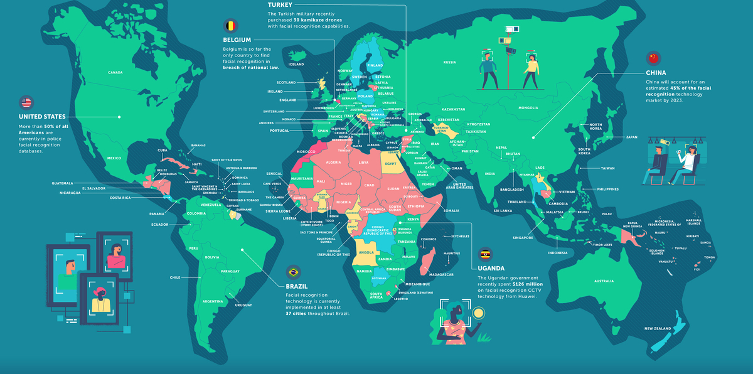
Our Team
Background on our Project Topic
Our AI Model
Our Results
Conclusion
Usage
In use
Approved for use
(not implemented)
Considering
technology
USA
Title VII & II of the Civil Rights Act of 1964
Age Discrimination in Employment Act
Americans with Disabilities Act
Equal Pay Act
Pregnancy Discrimination Act
Genetic Information Non-Discrimination Act
State Laws
No evidence of
use
Banned

Slide 6




Our Team
Background on our Project Topic
Our AI Model
Our Results
Conclusion
The Opportunities & Threats of Facial Recognition
Opportunities
Prove of Identity
Security
Threats
Surveillance of citizens
Tinder was accused of assigning desirability score to the different profiles
Racial & Gender Bias

Slide 7


Our Team
Background on our Project Topic
Our AI Model
Our Results
Conclusion
Our Objective
Facial Recognition
Recognition of famous people using Amazon’s Rekognition API
Recognition of image content using Amazon’s Rekognition API
Image Classification
Showing the Dangers & Limitations of Machine Learning through the classification of images through “Beauty Scores”
source: time.com

Slide 8

Our AI Model

Slide 9
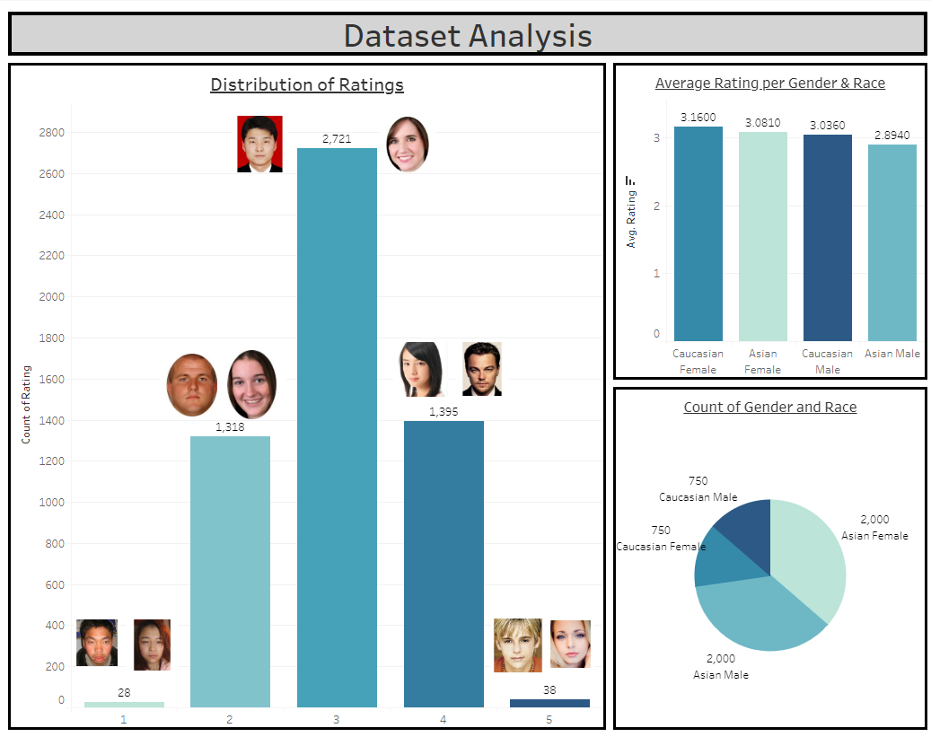
Our Team
Background on our Project Topic
Our AI Model
Our Results
Conclusion
Our Data
Data Source
SCUT-FBP5500-Database
Data Labeling
60 raters labeled the data with a "Beauty Score" from 1 to 5

Slide 10

Our Team
Background on our Project Topic
Our AI Model
Our Results
Conclusion
Model Considerations - Machine Learning Model
Machine learning is a new programming paradigm, a new way of communicating your wishes to a computer.
Notes:
SLIDE ELISA
We decided to limit ourselves to the observation of these 8, as they are incorporated in mayor anti-discrimination laws, like the Employment Equality Framework Directive 2000 of the European Union which aims to combat discrimination on grounds of disability, sexual orientation, religion or belief and age in the workplace, as well as the Racial Equality Directive 2000 and the Equal Treatment Directive 2006 on gender. A ban on discrimination based on these motives is also included in the Charter of Fundamental Rights of the European Union (Article 21).
In Brazil Protection from discrimination is contained in various pieces of legislation. The Constitution bans "any form" of discrimination, granting people the freedom of profession. Moreover, it also prohibits differences of positions, salaries or hiring procedures resulting from gender, age, colour (not "race") and marital status. The Labour Code prohibits, furthermore, job ads with reference to gender, age, colour (not "race"), family status, as well as the refusal of job, promotion or termination based on those same aspects plus pregnancy.
Additionally:
Law 5,473 (1968) prohibits discrimination in the recruiting programmes.
Law 7,716 (1989) prohibiting discrimination or prejudice of “race, colour, ethnic group, religion or national origin” in general. (not only workplace related).
Law 9,029 (1995) prohibiting any workplace discrimination based on gender, race, colour, marital status, family status or age.
Law 10,741 (2013) provides generally for the social protection of elderly citizens, including professional rights and prohibition of age discrimination in recruiting programmes, except for where the circumstances may justify the need for younger workers, such as the need for physical strength.
In spite of the different laws and regulations prohibiting different kinds of workplace discrimination, discrimination is not among the most popular causes of legal action. Individual discrimination claims are rare compared to claims based on overtime, equal pay for equal work and other ordinary employment rights. That being said, there has been an increasing trend over the last few years in Brazil.
Source: http://www.agediscrimination.info/international-age-discrimination/brazil
In the United States, workplace equality is aimed to achieve with the following acts:
Title VII and Title II of the Civil Rights Act of 1964 prohibiting discrimination against employees and applicants on the basis of race, color, sex (including pregnancy), national origin, and religion, as well as protecting employees from retaliation for complaining of discrimination, filing a charge, or assisting in an investigation of discrimination.
Age Discrimination in Employment Act (“ADEA”): The ADEA prohibits employment discrimination against people 40 years of age and older.
Americans with Disabilities Act (“ADA”): prohibiting discrimination against individuals (employees, applicants, and guests) with a disability and requires the provision of a reasonable accommodation to someone who is legally disabled.
Equal Pay Act (“EPA”): prohibits paying different wages to employees of different sexes who perform equal work under similar conditions.
Pregnancy Discrimination Act (“PDA”): prohibits discrimination against an employee because of pregnancy.
Genetic Information Non-Discrimination Act (“GINA”): GINA prohibits employers from discriminating against employees because of an employee’s “genetic information.”
Different State Laws, that apply only in the state in which they are enacted. Example: Laws against Sexual Orientation discrimination and Gender Identiy discrimination. For example in California, NY, Pennsylvania or Colorado both are prohibited in public and private employment. In Texas, South Carolina, Nebraska or Idaho none of these is prohibited.
Source: https://knowledge.leglobal.org/anti-discrimination-laws-in-usa/, http://outandequal.org/2017-workplace-equality-fact-sheet/
NOTE: Not gonna state & explain every single law.

Slide 11
Our Team
Background on our Project Topic
Our AI Model
Our Results
Conclusion
Model Considerations - Convolution Neural Network (CNN) Model
Goal of training: CNN Model prediction for facial beauty
Input of images that were labeled/classified with a “beauty score” from 1 to 5 (low to high) into the CNN by 60 raters
Training of model and split-up of our labelled data at a 80/20 ratio
80% (4,400) of the images were used for the training
20 % (1,100) of the images were used for testing
Notes:
SLIDE ELISA
We decided to limit ourselves to the observation of these 8, as they are incorporated in mayor anti-discrimination laws, like the Employment Equality Framework Directive 2000 of the European Union which aims to combat discrimination on grounds of disability, sexual orientation, religion or belief and age in the workplace, as well as the Racial Equality Directive 2000 and the Equal Treatment Directive 2006 on gender. A ban on discrimination based on these motives is also included in the Charter of Fundamental Rights of the European Union (Article 21).
In Brazil Protection from discrimination is contained in various pieces of legislation. The Constitution bans "any form" of discrimination, granting people the freedom of profession. Moreover, it also prohibits differences of positions, salaries or hiring procedures resulting from gender, age, colour (not "race") and marital status. The Labour Code prohibits, furthermore, job ads with reference to gender, age, colour (not "race"), family status, as well as the refusal of job, promotion or termination based on those same aspects plus pregnancy.
Additionally:
Law 5,473 (1968) prohibits discrimination in the recruiting programmes.
Law 7,716 (1989) prohibiting discrimination or prejudice of “race, colour, ethnic group, religion or national origin” in general. (not only workplace related).
Law 9,029 (1995) prohibiting any workplace discrimination based on gender, race, colour, marital status, family status or age.
Law 10,741 (2013) provides generally for the social protection of elderly citizens, including professional rights and prohibition of age discrimination in recruiting programmes, except for where the circumstances may justify the need for younger workers, such as the need for physical strength.
In spite of the different laws and regulations prohibiting different kinds of workplace discrimination, discrimination is not among the most popular causes of legal action. Individual discrimination claims are rare compared to claims based on overtime, equal pay for equal work and other ordinary employment rights. That being said, there has been an increasing trend over the last few years in Brazil.
Source: http://www.agediscrimination.info/international-age-discrimination/brazil
In the United States, workplace equality is aimed to achieve with the following acts:
Title VII and Title II of the Civil Rights Act of 1964 prohibiting discrimination against employees and applicants on the basis of race, color, sex (including pregnancy), national origin, and religion, as well as protecting employees from retaliation for complaining of discrimination, filing a charge, or assisting in an investigation of discrimination.
Age Discrimination in Employment Act (“ADEA”): The ADEA prohibits employment discrimination against people 40 years of age and older.
Americans with Disabilities Act (“ADA”): prohibiting discrimination against individuals (employees, applicants, and guests) with a disability and requires the provision of a reasonable accommodation to someone who is legally disabled.
Equal Pay Act (“EPA”): prohibits paying different wages to employees of different sexes who perform equal work under similar conditions.
Pregnancy Discrimination Act (“PDA”): prohibits discrimination against an employee because of pregnancy.
Genetic Information Non-Discrimination Act (“GINA”): GINA prohibits employers from discriminating against employees because of an employee’s “genetic information.”
Different State Laws, that apply only in the state in which they are enacted. Example: Laws against Sexual Orientation discrimination and Gender Identiy discrimination. For example in California, NY, Pennsylvania or Colorado both are prohibited in public and private employment. In Texas, South Carolina, Nebraska or Idaho none of these is prohibited.
Source: https://knowledge.leglobal.org/anti-discrimination-laws-in-usa/, http://outandequal.org/2017-workplace-equality-fact-sheet/
NOTE: Not gonna state & explain every single law.

Slide 12
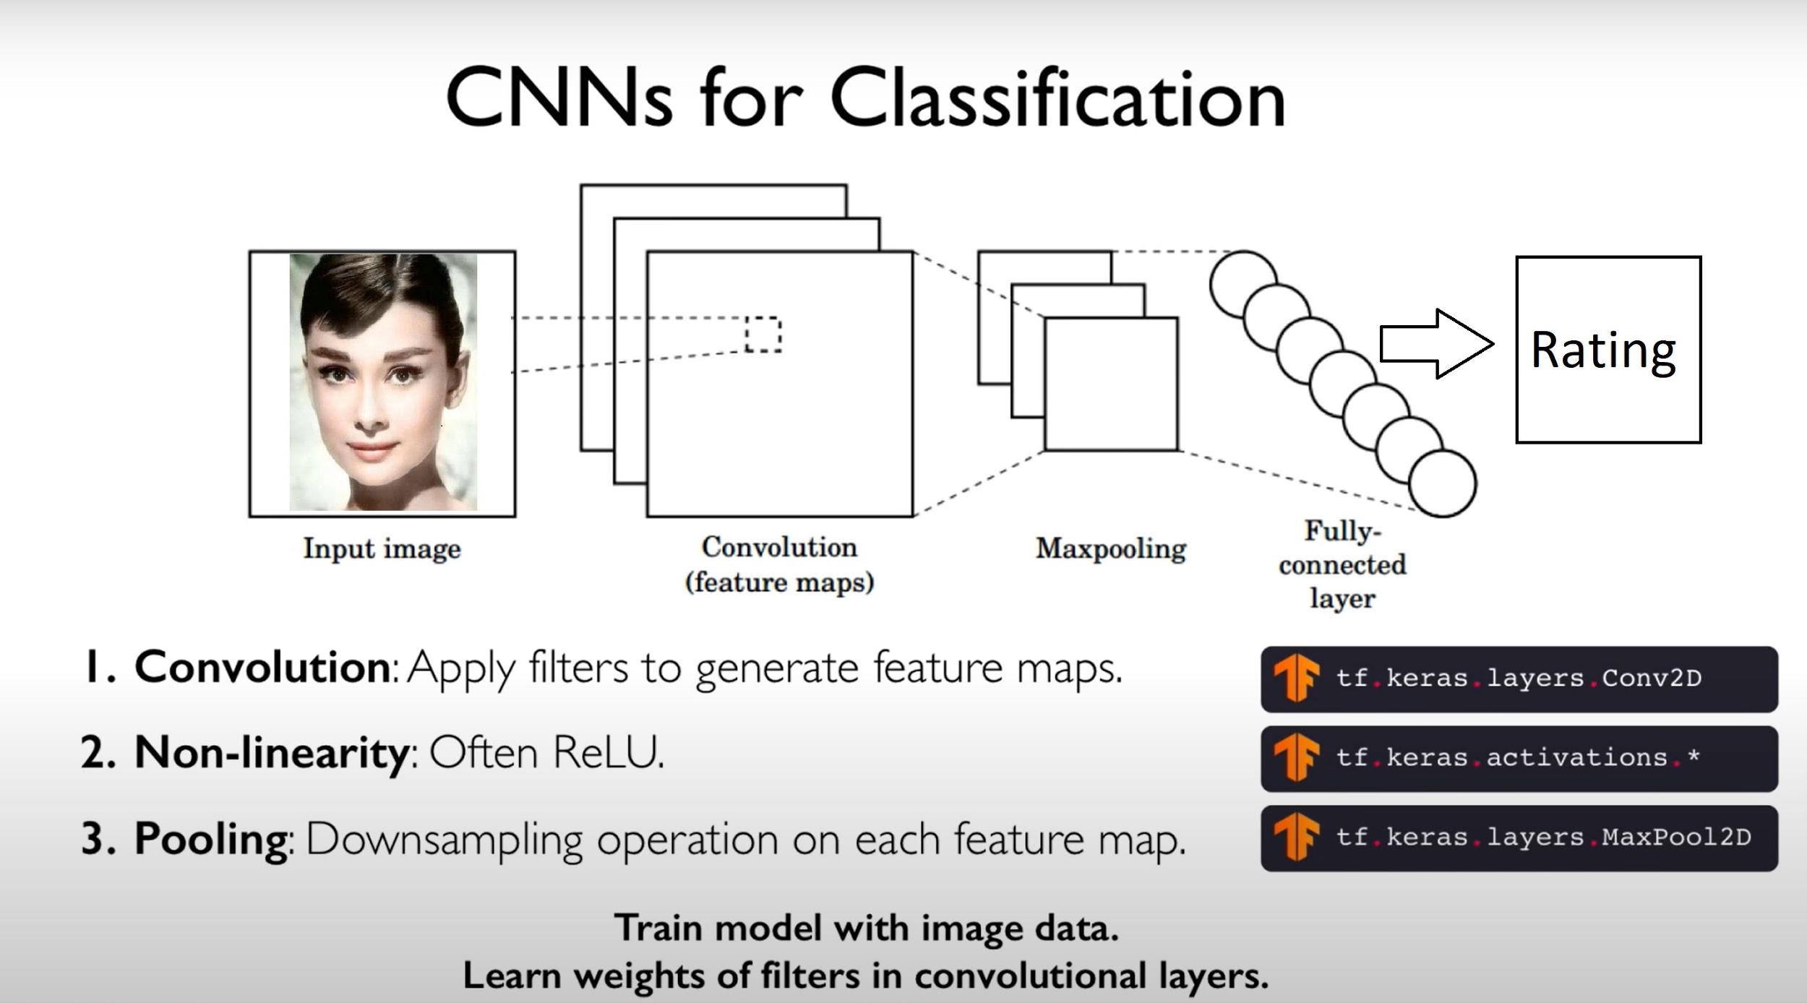
Our Team
Background on our Project Topic
Our AI Model
Our Results
Conclusion
Model Design – Convolutional Neural Network
Notes:
SLIDE ELISA
We decided to limit ourselves to the observation of these 8, as they are incorporated in mayor anti-discrimination laws, like the Employment Equality Framework Directive 2000 of the European Union which aims to combat discrimination on grounds of disability, sexual orientation, religion or belief and age in the workplace, as well as the Racial Equality Directive 2000 and the Equal Treatment Directive 2006 on gender. A ban on discrimination based on these motives is also included in the Charter of Fundamental Rights of the European Union (Article 21).
In Brazil Protection from discrimination is contained in various pieces of legislation. The Constitution bans "any form" of discrimination, granting people the freedom of profession. Moreover, it also prohibits differences of positions, salaries or hiring procedures resulting from gender, age, colour (not "race") and marital status. The Labour Code prohibits, furthermore, job ads with reference to gender, age, colour (not "race"), family status, as well as the refusal of job, promotion or termination based on those same aspects plus pregnancy.
Additionally:
Law 5,473 (1968) prohibits discrimination in the recruiting programmes.
Law 7,716 (1989) prohibiting discrimination or prejudice of “race, colour, ethnic group, religion or national origin” in general. (not only workplace related).
Law 9,029 (1995) prohibiting any workplace discrimination based on gender, race, colour, marital status, family status or age.
Law 10,741 (2013) provides generally for the social protection of elderly citizens, including professional rights and prohibition of age discrimination in recruiting programmes, except for where the circumstances may justify the need for younger workers, such as the need for physical strength.
In spite of the different laws and regulations prohibiting different kinds of workplace discrimination, discrimination is not among the most popular causes of legal action. Individual discrimination claims are rare compared to claims based on overtime, equal pay for equal work and other ordinary employment rights. That being said, there has been an increasing trend over the last few years in Brazil.
Source: http://www.agediscrimination.info/international-age-discrimination/brazil
In the United States, workplace equality is aimed to achieve with the following acts:
Title VII and Title II of the Civil Rights Act of 1964 prohibiting discrimination against employees and applicants on the basis of race, color, sex (including pregnancy), national origin, and religion, as well as protecting employees from retaliation for complaining of discrimination, filing a charge, or assisting in an investigation of discrimination.
Age Discrimination in Employment Act (“ADEA”): The ADEA prohibits employment discrimination against people 40 years of age and older.
Americans with Disabilities Act (“ADA”): prohibiting discrimination against individuals (employees, applicants, and guests) with a disability and requires the provision of a reasonable accommodation to someone who is legally disabled.
Equal Pay Act (“EPA”): prohibits paying different wages to employees of different sexes who perform equal work under similar conditions.
Pregnancy Discrimination Act (“PDA”): prohibits discrimination against an employee because of pregnancy.
Genetic Information Non-Discrimination Act (“GINA”): GINA prohibits employers from discriminating against employees because of an employee’s “genetic information.”
Different State Laws, that apply only in the state in which they are enacted. Example: Laws against Sexual Orientation discrimination and Gender Identiy discrimination. For example in California, NY, Pennsylvania or Colorado both are prohibited in public and private employment. In Texas, South Carolina, Nebraska or Idaho none of these is prohibited.
Source: https://knowledge.leglobal.org/anti-discrimination-laws-in-usa/, http://outandequal.org/2017-workplace-equality-fact-sheet/
NOTE: Not gonna state & explain every single law.

Slide 13


Our Results

Slide 14
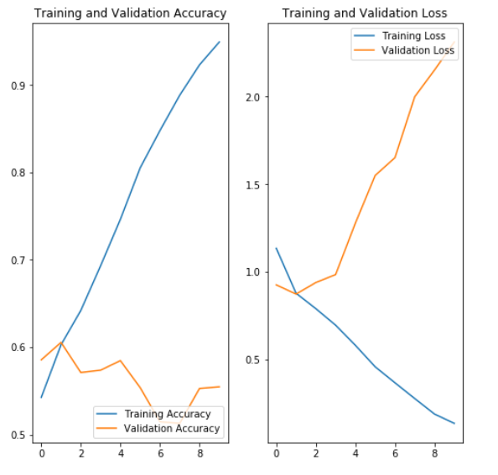
Our Team
Background on our Project Topic
Our AI Model
Our Results
Conclusion
Results
Training Data Accuracy: An accuracy of 95% on the training dataset
Validation Data Accuracy: An accuracy of 56% on the testing dataset
The prediction accuracy can be increased with the various methods, such as using bigger datasets and deeper network architecture, regularization, data augmentation, and so on.

Slide 15

Our Team
Background on our Project Topic
Our AI Model
Our Results
Conclusion
Architecture of
the Web App
Notes:
SLIDE ELISA
We decided to limit ourselves to the observation of these 8, as they are incorporated in mayor anti-discrimination laws, like the Employment Equality Framework Directive 2000 of the European Union which aims to combat discrimination on grounds of disability, sexual orientation, religion or belief and age in the workplace, as well as the Racial Equality Directive 2000 and the Equal Treatment Directive 2006 on gender. A ban on discrimination based on these motives is also included in the Charter of Fundamental Rights of the European Union (Article 21).
In Brazil Protection from discrimination is contained in various pieces of legislation. The Constitution bans "any form" of discrimination, granting people the freedom of profession. Moreover, it also prohibits differences of positions, salaries or hiring procedures resulting from gender, age, colour (not "race") and marital status. The Labour Code prohibits, furthermore, job ads with reference to gender, age, colour (not "race"), family status, as well as the refusal of job, promotion or termination based on those same aspects plus pregnancy.
Additionally:
Law 5,473 (1968) prohibits discrimination in the recruiting programmes.
Law 7,716 (1989) prohibiting discrimination or prejudice of “race, colour, ethnic group, religion or national origin” in general. (not only workplace related).
Law 9,029 (1995) prohibiting any workplace discrimination based on gender, race, colour, marital status, family status or age.
Law 10,741 (2013) provides generally for the social protection of elderly citizens, including professional rights and prohibition of age discrimination in recruiting programmes, except for where the circumstances may justify the need for younger workers, such as the need for physical strength.
In spite of the different laws and regulations prohibiting different kinds of workplace discrimination, discrimination is not among the most popular causes of legal action. Individual discrimination claims are rare compared to claims based on overtime, equal pay for equal work and other ordinary employment rights. That being said, there has been an increasing trend over the last few years in Brazil.
Source: http://www.agediscrimination.info/international-age-discrimination/brazil
In the United States, workplace equality is aimed to achieve with the following acts:
Title VII and Title II of the Civil Rights Act of 1964 prohibiting discrimination against employees and applicants on the basis of race, color, sex (including pregnancy), national origin, and religion, as well as protecting employees from retaliation for complaining of discrimination, filing a charge, or assisting in an investigation of discrimination.
Age Discrimination in Employment Act (“ADEA”): The ADEA prohibits employment discrimination against people 40 years of age and older.
Americans with Disabilities Act (“ADA”): prohibiting discrimination against individuals (employees, applicants, and guests) with a disability and requires the provision of a reasonable accommodation to someone who is legally disabled.
Equal Pay Act (“EPA”): prohibits paying different wages to employees of different sexes who perform equal work under similar conditions.
Pregnancy Discrimination Act (“PDA”): prohibits discrimination against an employee because of pregnancy.
Genetic Information Non-Discrimination Act (“GINA”): GINA prohibits employers from discriminating against employees because of an employee’s “genetic information.”
Different State Laws, that apply only in the state in which they are enacted. Example: Laws against Sexual Orientation discrimination and Gender Identiy discrimination. For example in California, NY, Pennsylvania or Colorado both are prohibited in public and private employment. In Texas, South Carolina, Nebraska or Idaho none of these is prohibited.
Source: https://knowledge.leglobal.org/anti-discrimination-laws-in-usa/, http://outandequal.org/2017-workplace-equality-fact-sheet/
NOTE: Not gonna state & explain every single law.

Slide 16

Conclusion

Slide 17



Our Team
Background on our Project Topic
Our AI Model
Our Results
Conclusion
Limitations
Data in general
Sample Size is limited to 5,500
Sample Diversity (Sex & Ethnicity)
Photo must meet certain quality & size
Usage of make-up can change face
Training Data
Inherently Biased
Rater Diversity
Produced in China

Slide 18
Our Team
Background on our Project Topic
Our AI Model
Our Results
Conclusion
Conclusion
Face Recognition and Image Classification can do remarkable things
Data Scientists have to be aware of the ethical implications of using Machine Learning

Slide 19

Our Team
Background on our Project Topic
Our AI Model
Our Results
Conclusion
Questions??
https://pc.onelakeofwine.com/

Slide 20
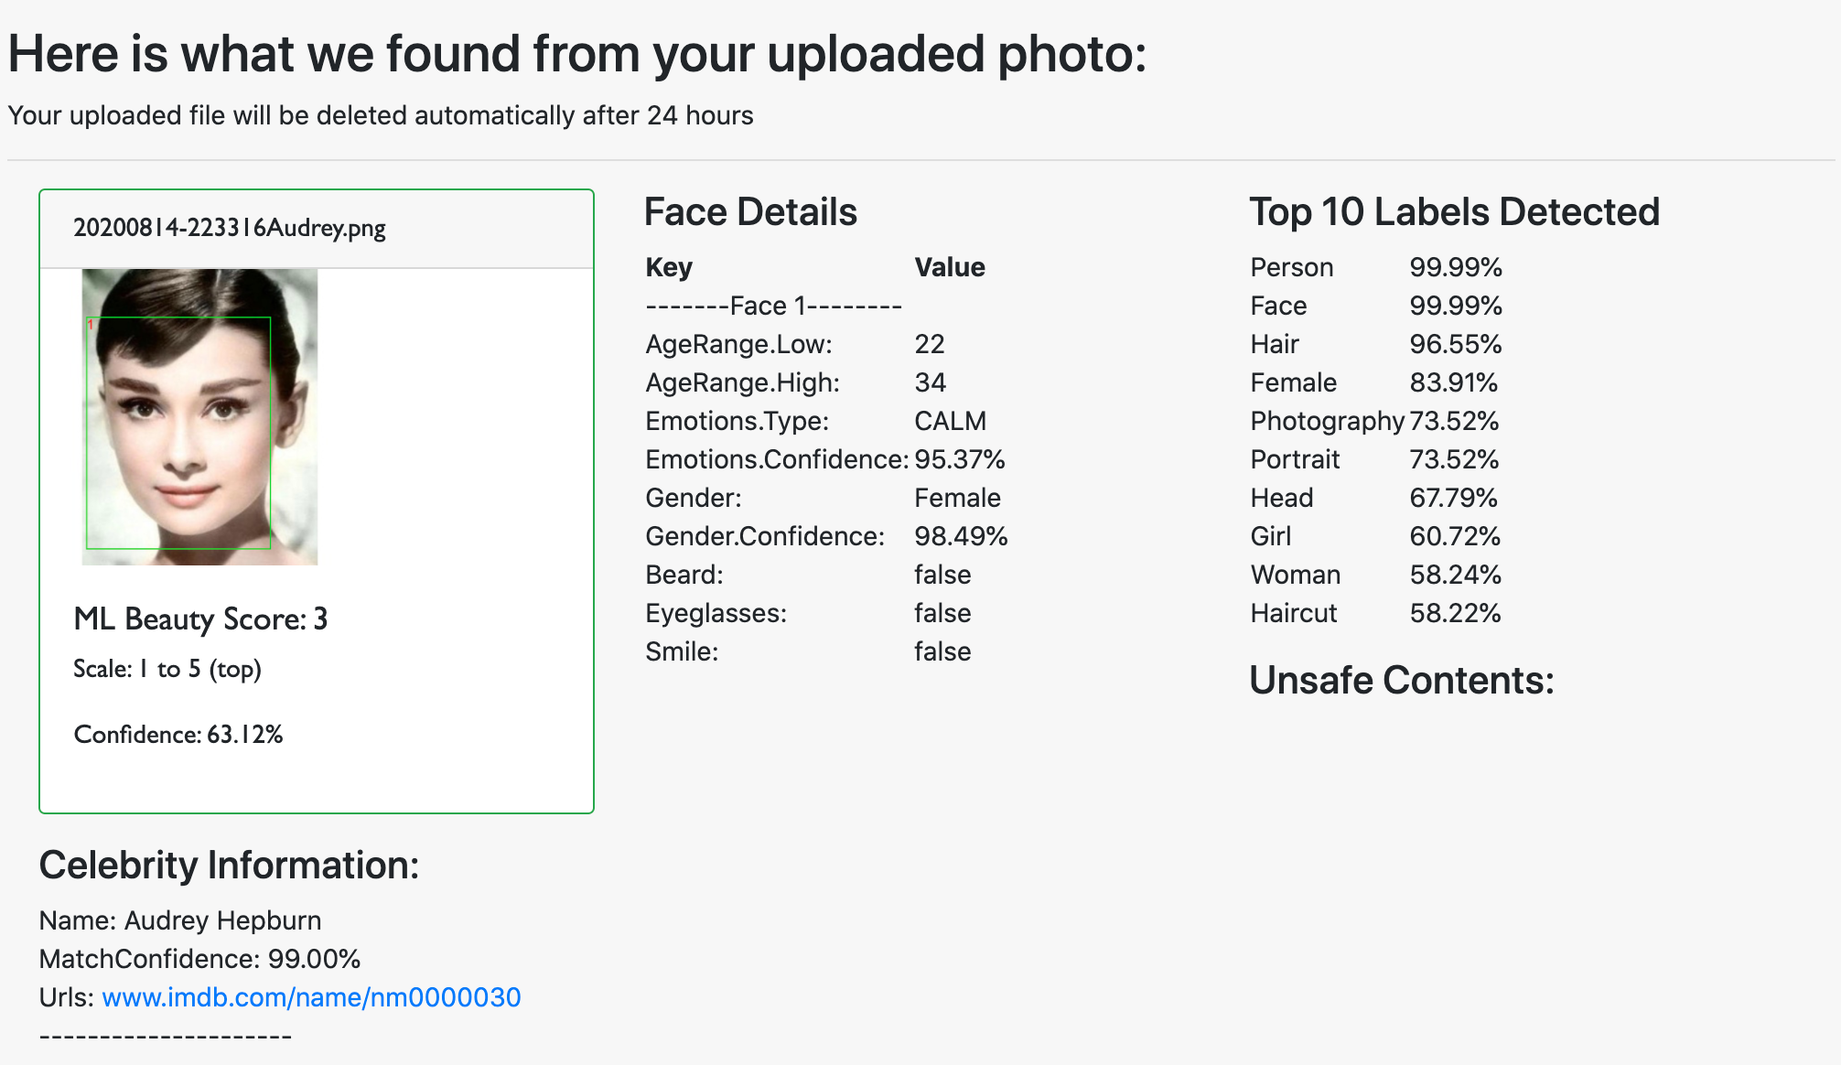
Our Team
Background on our Project Topic
Our AI Model
Our Results
Conclusion
Audrey Hepburn
Notes:
SLIDE ELISA
We decided to limit ourselves to the observation of these 8, as they are incorporated in mayor anti-discrimination laws, like the Employment Equality Framework Directive 2000 of the European Union which aims to combat discrimination on grounds of disability, sexual orientation, religion or belief and age in the workplace, as well as the Racial Equality Directive 2000 and the Equal Treatment Directive 2006 on gender. A ban on discrimination based on these motives is also included in the Charter of Fundamental Rights of the European Union (Article 21).
In Brazil Protection from discrimination is contained in various pieces of legislation. The Constitution bans "any form" of discrimination, granting people the freedom of profession. Moreover, it also prohibits differences of positions, salaries or hiring procedures resulting from gender, age, colour (not "race") and marital status. The Labour Code prohibits, furthermore, job ads with reference to gender, age, colour (not "race"), family status, as well as the refusal of job, promotion or termination based on those same aspects plus pregnancy.
Additionally:
Law 5,473 (1968) prohibits discrimination in the recruiting programmes.
Law 7,716 (1989) prohibiting discrimination or prejudice of “race, colour, ethnic group, religion or national origin” in general. (not only workplace related).
Law 9,029 (1995) prohibiting any workplace discrimination based on gender, race, colour, marital status, family status or age.
Law 10,741 (2013) provides generally for the social protection of elderly citizens, including professional rights and prohibition of age discrimination in recruiting programmes, except for where the circumstances may justify the need for younger workers, such as the need for physical strength.
In spite of the different laws and regulations prohibiting different kinds of workplace discrimination, discrimination is not among the most popular causes of legal action. Individual discrimination claims are rare compared to claims based on overtime, equal pay for equal work and other ordinary employment rights. That being said, there has been an increasing trend over the last few years in Brazil.
Source: http://www.agediscrimination.info/international-age-discrimination/brazil
In the United States, workplace equality is aimed to achieve with the following acts:
Title VII and Title II of the Civil Rights Act of 1964 prohibiting discrimination against employees and applicants on the basis of race, color, sex (including pregnancy), national origin, and religion, as well as protecting employees from retaliation for complaining of discrimination, filing a charge, or assisting in an investigation of discrimination.
Age Discrimination in Employment Act (“ADEA”): The ADEA prohibits employment discrimination against people 40 years of age and older.
Americans with Disabilities Act (“ADA”): prohibiting discrimination against individuals (employees, applicants, and guests) with a disability and requires the provision of a reasonable accommodation to someone who is legally disabled.
Equal Pay Act (“EPA”): prohibits paying different wages to employees of different sexes who perform equal work under similar conditions.
Pregnancy Discrimination Act (“PDA”): prohibits discrimination against an employee because of pregnancy.
Genetic Information Non-Discrimination Act (“GINA”): GINA prohibits employers from discriminating against employees because of an employee’s “genetic information.”
Different State Laws, that apply only in the state in which they are enacted. Example: Laws against Sexual Orientation discrimination and Gender Identiy discrimination. For example in California, NY, Pennsylvania or Colorado both are prohibited in public and private employment. In Texas, South Carolina, Nebraska or Idaho none of these is prohibited.
Source: https://knowledge.leglobal.org/anti-discrimination-laws-in-usa/, http://outandequal.org/2017-workplace-equality-fact-sheet/
NOTE: Not gonna state & explain every single law.

Slide 21
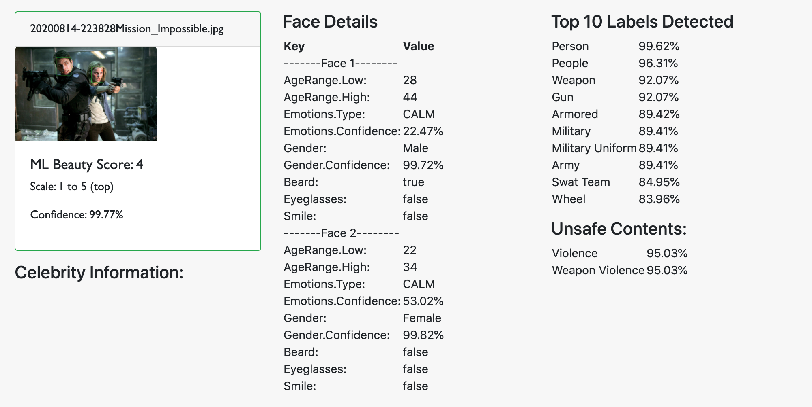
Our Team
Background on our Project Topic
Our AI Model
Our Results
Conclusion
Unsafe Contents

